Slide 1
6.Neural Network & Recommendation System:

Slide 2
Neuron representation and model
Artificial Neural Network is computing system inspired by biological neural network that constitute animal brain. Such systems “learn” to perform tasks by considering examples, generally without being programmed with any task-specific rules.
The Neural Network is constructed from 3 type of layers:
Input layer — initial data for the neural network.
Hidden layers — intermediate layer between input and output layer and place where all the computation is done.
Output layer — produce the result for given inputs.
A neural network is composed of many neurons. Neurons are arranged into linear layers but have non-linear activations. The internal layers of a neural network are called the "hidden" layers.

Slide 3
Neuron representation and model
Artificial Neural Networks (ANN) are inspired by Biological or Natural Neural Networks (BNN). The purpose of ANN is to stimulate the functionality of a human brain such that it can mimic and take action as a human brain does. Given that ANN is a replica of the human brain so naturally, the components of ANN are also the same as that of the biological neural network.
A neural network is a set or system of interconnected units where each of the connections has a weight attached to it. These interconnected units are also called neurons. The main building block of a neural network is a Neuron. A neuron is a nerve cell that carries electrical impulses. It is the core working unit of the brain that has the responsibility of transmitting information to every other cell in the body.

Slide 4
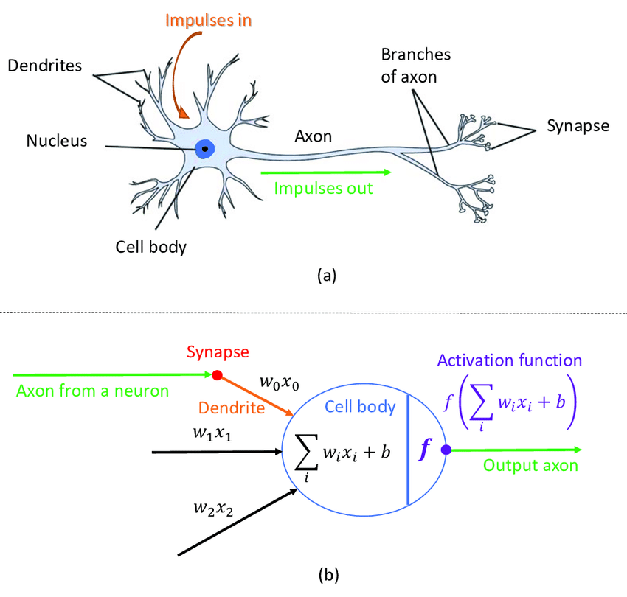
Neuron representation and model

Slide 5


Slide 6

FIG: Neural Network Architecture

Slide 7
Neuron representation and model
There are 3 yellow circles on the image above. They represent the input layer and usually are noted as vector X. There are 4 blue and 4 green circles that represent the hidden layers. These circles represent the “activation” nodes and usually are noted as W or θ. The red circle is the output layer or the predicted value (or values in case of multiple output classes/types).
Each node relates to each node from the next layer and each connection (black arrow) has weight. Weight can be seen as impact that that node has on the node from the next layer. So, if we look on one node it would look like this

Slide 8
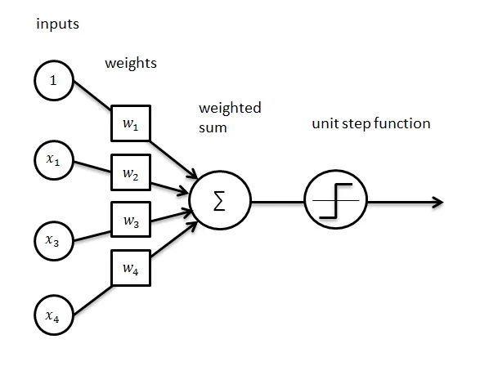
FIG 2: Node from Neural Network.

Slide 9
Neuron representation and model
Let’s look at the top blue node (“FIG 1”). All the nodes from the previous layer (yellow) relate to it. All these connections represent the weights (impact). When all the node values from the yellow layer are multiplied with their weight and all this is summarized it gives some value for the top blue node. The blue node has predefined “activation” function (unit step function on “FIG 2”) which defines if this node will be “activated” or how “active” it will be, based on the summarized value. The additional node with value 1 is called “bias” node.

Slide 10
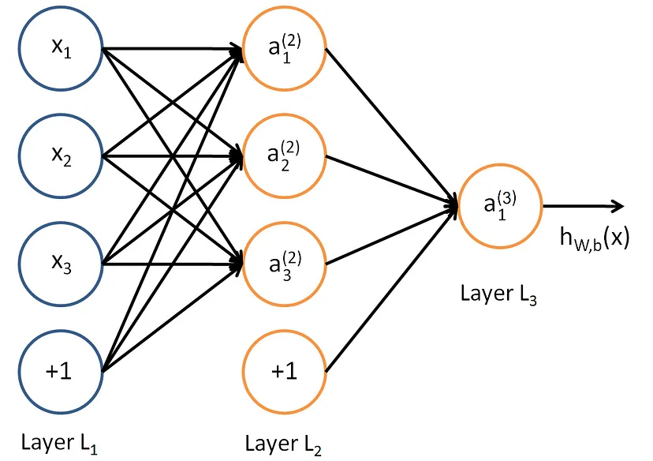
Model Representation Mathematics
To understand the mathematical equations, I will use a simpler Neural Network model. This model will have 4 input nodes (3 + 1 “bias”). One hidden layer with 4 nodes (3 + 1 “bias”) and one output node.
FIG 3: Simple Neural Network

Slide 11
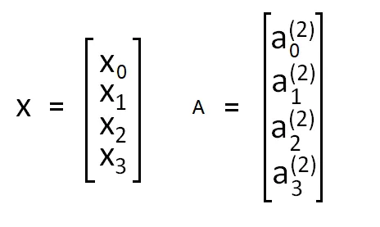
Model Representation Mathematics
We are going to mark the “bias” nodes as x₀ and a₀ respectively. So, the input nodes can be placed in one vector X and the nodes from the hidden layer in vector A.
FIG 4: X (input layer) and A (hidden layer) vector
The weights (arrows) are usually noted as θ or W. In this case I will note them as θ. The weights between the input and hidden layer will represent 3x4 matrix. And the weights between the hidden layer and the output layer will represent 1x4 matrix.

Slide 12
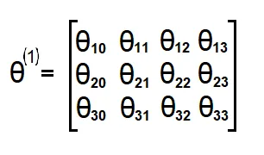
Model Representation Mathematics
If network has a units in layer j and b​ units in layer j+1, then θⱼ will be of dimension b​×(a+1).
FIG 5: Layer 1 Weights Matrix (θ)
Next, what we want is to compute the “activation” nodes for the hidden layer. To do that we need to multiply the input vector X and weights matrix θ¹ for the first layer (X*θ¹)and then apply the activation function g. What we get is :

Slide 13
Model Representation Mathematics
This example is with only one hidden layer and 4 nodes there. If we try to generalize for Neural Network with multiple hidden layers and multiple nodes in each of the layers we would get next formula.
FIG 8: Generalized Compute node value function
Where we have L layers with (n) nodes and L-1 layer with (m) nodes.

Slide 14
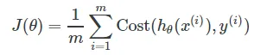
Cost function
Let’s start with defining the general equation for the cost function. This function represent the sum of the error, difference between the predicted value and the real (labeled) value.
FIG 9: General Cost function.
Since this is type of a classification problem y can only take discrete values {0,1}. It can only be in one type of class. For example, if we classify images of dogs (class 1), cats (class 2) and birds (class 3). If the input image is dog. The output classes will be value 1 for dog class and value 0 for the other classes.

Slide 15
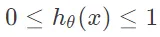
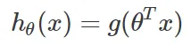
Cost function
This means that we want our hypothesis to satisfy :
FIG 10: Hypothesis function range values .
So that’s why we will define our hypothesis as :
FIG 11: Hypothesis function
Where g in this case will be Sigmoid function, since this function has range values between (0,1).

Slide 16
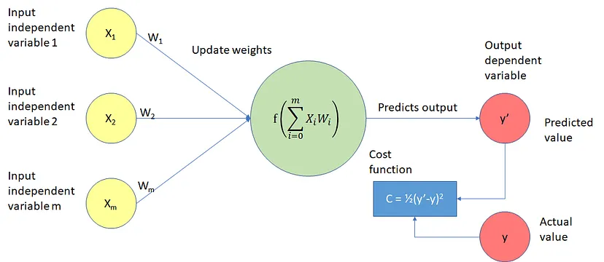
Cost function

Slide 17
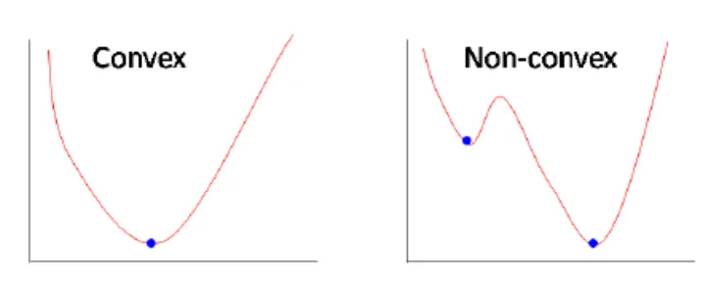
Cost function
Our goal is to optimize the cost function, so we need to find min J(θ). But Sigmoid function is a “non-convex” function . which means that there are multiple local minimums. So, it’s not guaranteed to converge (find) to the global minimum. What we need is “convex” function in order gradient descent algorithm to be able to find the global minimum (minimize J(θ)). To do that we use log function.
FIG 13: Convex vs Non-convex function.
So that’s why we use following cost function for neural networks

Slide 18
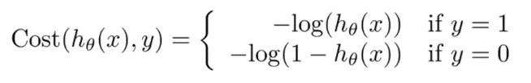
Cost function
FIG 14 : Neural Network cost function.
In case where labeled value y is equal to 1 the hypothesis is -log(h(x)) or -log(1-h(x)) otherwise.
The intuition is simple if we look at the function graphs. Let first look at the case where y=1. Then -log(h(x)) would look like the graph below. And we are only interested in the (0,1) x-axis interval since hypothesis can only take values in that range (“ FIG 10”).

Slide 19
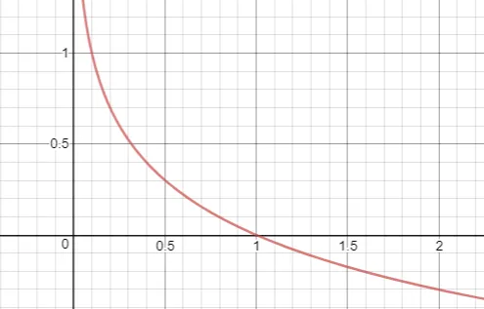
Cost function
FIG 15: Cost function -log(h(x))
What we can see from the graph is that if y=1 and h(x) approaches value of 1 (x-axis) the cost approaches the value 0 (h(x)-y would be 0) since it’s the right prediction. Otherwise, if h(x) approaches 0 the cost function goes to infinity (very large cost).

Slide 20
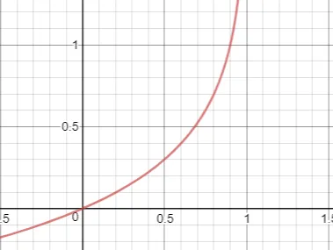
Cost function
In the other case where y=0, the cost function is -log(1-h(x)) .
FIG 16: -log(1-h) cost function
From the graph here we can see that if h(x) approaches value of 0 the cost would approach 0 since it’s also the right prediction in this case.

Slide 21
Cost function
Since y (labeled value) is always equal to 0 or 1 we can write cost function in one equation.
FIG 17: Cost function equation.
If we fully write our cost function with the summation, we will get:
FIG 18: Cost function in case of one output node .

Slide 22
Cost function
And this is for the case where there is only one node in the output layer of Neural Network. If we generalize this for multiple output nodes (multiclass classification) what we get is:
FIG 19: Generalized Cost function.
The right parts of the equations represent cost function “regularization”. This regularization prevent the data from “overfitting”, by reducing the magnitude/values of θ.

Slide 23
Cost function
And this is for the case where there is only one node in the output layer of Neural Network. If we generalize this for multiple output nodes (multiclass classification) what we get is:
FIG 19: Generalized Cost function.
The right parts of the equations represent cost function “regularization”. This regularization prevent the data from “overfitting”, by reducing the magnitude/values of θ.

Slide 24
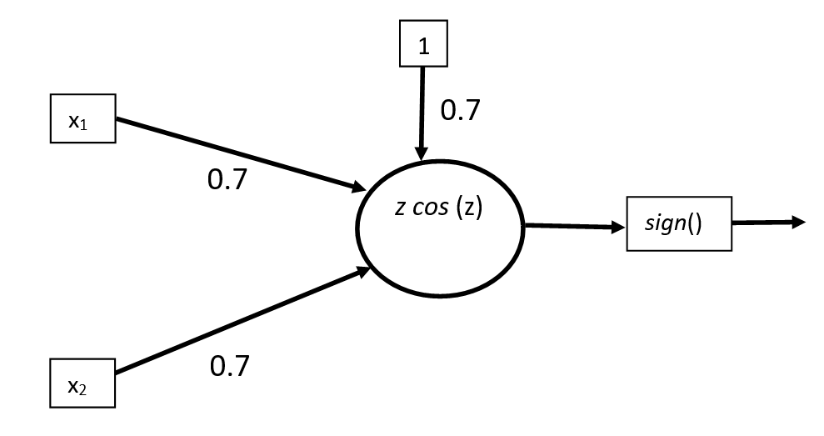
A single neuron solution to the XOR problem
Fig. 1

Slide 25
A single neuron solution to the XOR problem
Fig. 1: A single neuron solution to the XOR problem. A single neuron with the GCU activation function can learn the XOR dataset shown below exactly. The signum function at the output is used to map output values to class -1 or 1. The input and output are assumed to be bipolar (that is +1 or -1, instead of binary 0 and 1) for convenience. The decision boundary correspond to inputs for which z = w.x+b = 0. If z = 0 is the only zero of the activation function, then the decision boundary is a single hyperplane corresponding to z = w.x+b = 0. However, since z*cos(z) has multiple zeros, the GCU has a hyperplane decision boundary corresponding to each zero; allowing the XOR problem to be solved with a single neuron!

Slide 26
A single neuron solution to the XOR problem
The famous XOR problem is task of training a neural network to learn the XOR gate function. It was first pointed out by Papert and Minsky that a single neuron cannot learn the XOR function since a single hyperplane (line in this case) cannot separate the output classes for this function definition. This fundamental limitation of single neurons (or single layer networks) lead to pessimistic predictions for the future of neural network research and was responsible for a brief hiatus in the history of AI. In the following, we show that this issue does not apply to neurons with oscillatory activation function (like GCU).
The XOR problem is the task of learning the following dataset:

Slide 27
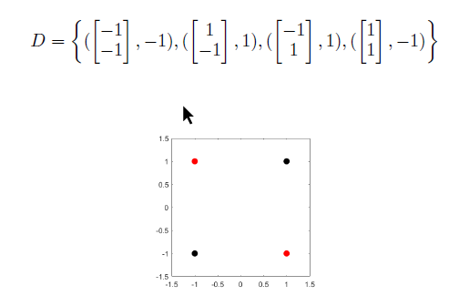
A single neuron solution to the XOR problem
Fig. 2: The XOR problem involves the task of learning the XOR function with the smallest network. The red dots must be classified as positive (1) and the black dots must be classified as negative (-1). A single line (hyperplane) cannot separate the two classes.

Slide 28
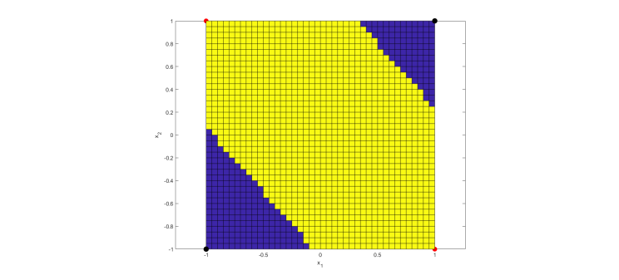
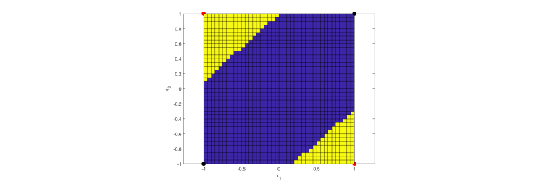
A single neuron solution to the XOR problem
FIG:3

Slide 29
A single neuron solution to the XOR problem
Fig. 3: Two solutions to the XOR problem learnt by a single neuron using the GCU activation function. Points in yellow were assigned a class label of +1 and points in blue were assigned a class label of -1 by a single GCU neuron.

Slide 30
A single neuron solution to the XOR problem
Fig. 3: Two solutions to the XOR problem learnt by a single neuron using the GCU activation function. Points in yellow were assigned a class label of +1 and points in blue were assigned a class label of -1 by a single GCU neuron.

Slide 31
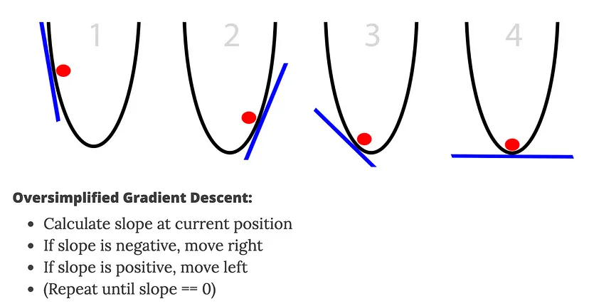
Gradient descent for a neuron.

Slide 32
Gradient descent for a neuron.
Gradient Descent is a method to minimize the Cost Function to update the Neurons weights. This method tells your Neural Network how to calculate the Cost Function in a fast efficient manner to minimize the difference between the actual and expected outputs.
The easiest to understand and most common example is comparing your Cost Function to a ball trying to find the lowest point by updating its slope.

Slide 33
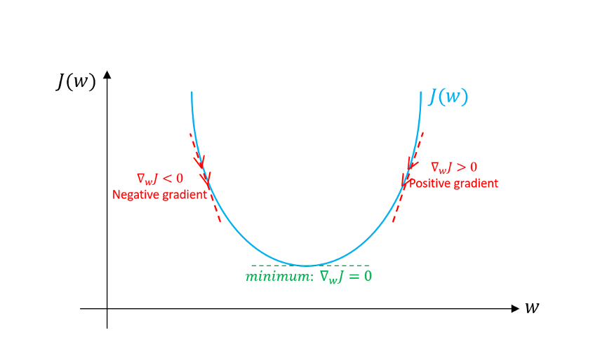
Gradient descent for a neuron.
Gradient Descent has been doing a fairly good job in helping with these two necessities. How Gradient Descent helps is:

Slide 34
Gradient descent for a neuron.
Using Gradient Descent, we get the formula to update the weights or the beta coefficients of the equation we have in the form of Z = W0 + W1X1 + W2X2 + …+ WnXn .
Wnew = Wold – (α * dL/dw)
were,
Wnew = the new weight of Xi
Wold = the old weight of the Xi
α = learning rate
dL/dw is the partial derivative of the loss function for each of the Xs. It is the rate of change of the loss function to the change in weight.

Slide 35
Neural network-Back propagation algorithm
The backpropagation equations provide us with a way of computing the gradient of the cost function. Let's explicitly write this out in the form of an algorithm:
Input x: Set the corresponding activation a1for the input layer.
Feedforward: For each l=2,3,…,L compute zl=wlal−1+bl and al=σ(zl).
Output error δL: Compute the vector δL=∇aC⊙σ′(zL).
Backpropagate the error: For each l=L−1,L−2,…,2 compute δl=((wl+1)Tδl+1)⊙σ′(zl).
Output: The gradient of the cost function is given by ∂C∂wljk=al−1kδlj
and ∂C∂blj=δlj.

Slide 36
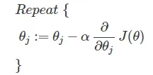
Neural network-Back propagation algorithm
What we want to do is minimize the cost function J(θ) using the optimal set of values for θ (weights). Backpropagation is a method we use to compute the partial derivative of J(θ).
This partial derivative value is then used in Gradient descent algorithm (“Image 23”) for calculating the θ values for the Neural Network that minimize the cost function J(θ).
Image 23: General form of gradient descent
Backpropagation algorithm has 5 steps:
Set a(1) = X; for the training examples.
Perform forward propagation and compute a(l) for the other layers (l = 2…L).
Use y and compute the delta value for the last layer δ(L) = h(x) — y .

Slide 37
Neural network-Back propagation algorithm
4.Compute the δ(l) values backwards for each layer (described in “Math behind Backpropagation” section).
5.Calculate derivative values Δ(l) = (a(l))^T ∘ δ(l+1) for each layer, which represent the derivative of cost J(θ) with respect to θ(l) for layer l .
Backpropagation is about determining how changing the weights impact the overall cost in the neural network.
What it does is propagating the “error” backwards in the neural network. On the way back it is finding how much each weight is contributing in the overall “error”. The weights that contribute more to the overall “error” will have larger derivation values, which means that they will change more (when computing Gradient descent).
Now that we have sense of what Backpropagation algorithm .

Slide 38
Multiclass classification with neural network
Multiclass classification is a machine learning challenge focused on categorizing data into more than two classes. While binary classification involves distinguishing between only two classes, multiclass classification expands this scope to involve distinguishing between multiple classes. In essence, the goal is to train a model that can effectively sort instances into various predefined categories, providing a nuanced solution for scenarios where items can belong to more than two exclusive groups. This approach is commonly employed in tasks such as handwriting recognition, email categorization, and image classification involving more than two distinct categories.
Multiclass classification is a type of machine learning task where the goal is to categorize instances into one of several predefined classes. Unlike binary classification, where there are only two possible outcomes, multiclass classification involves distinguishing between multiple classes or categories. The fundamental idea is to teach a model to assign the most appropriate class label to each instance based on its features.

Slide 39
Multiclass classification with neural network
Multiclass classification finds application in a wide range of real-world scenarios. Consider email categorization, where emails need to be sorted into categories like “spam,” “ham” (non-spam), or “important.” Another classic example is handwritten digit recognition, where the task is to identify which digit (0 through 9) is written in a given image. Other applications include speech recognition, sentiment analysis, and image classification into multiple categories.
Training a multiclass classification model involves employing specific techniques to ensure accurate class assignment. One common approach is to use softmax activation in the output layer of the neural network. SoftMax converts the raw model outputs into probabilities, assigning higher probabilities to the correct classes. Additionally, categorical cross-entropy loss is often used as the objective function during training. This loss function measures the dissimilarity between the predicted probabilities and the actual class labels, guiding the model to minimize errors and improve accuracy.

Slide 40
Popularity Based Recommendation System
Recommender engines (REs) also known as recommender systems are becoming very popular software tools as they can provide good recommendation about a product to a user. The suggestions offered are focused at helping their users in various decision-making processes such as what products to buy, which music to listen and whose profiles to browse, or what news to read. A recommendation engine recommends the most relevant data to the users by filtering the data using different algorithms. Recommended systems are useful in so many areas like news, movies, research articles, music, books, search queries, social tags, and products in general. As the name implies Popularity based recommendation system works with the ongoing trend. It basically uses the items which are more popular at present.

Slide 41
Popularity Based Recommendation System
Steps involved in building a popularity-based recommendation system are as follows: 1) Downloading the required data set. 2) Build a popularity-based model and retrieve the scores. 3) Find the scores obtained. 4) Based on the computed scores, make the appropriate recommendations according to the input. First, I will import the NumPy and the pandas which I am going to use a lot and the class that I have created which includes the methods like create that basically creates the recommendations and the recommend method that recommends the items to the user. After that I will load the data of comma separated value (CSV).Later I will sort the sound name based on the how many users have listened to the sound name. In next step code splits the dataset into training dataset and test dataset using 80–20 ratio. This facilitates to create an instance of popularity-based recommender's class. Next, I will use the popularity model to make the predictions. The overall system design has the following phases: A) Data set selection B) Training the Popularity Based Recommendation system C) Recommendations

Slide 42
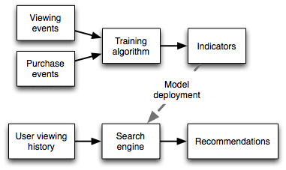
Popularity Based Recommendation System
Fig : Architecture of Popularity Based
recommendation system .
As shown in the above (Fig) , describes that Recommendation is created by splitting the dataset into training as well as testing dataset. Recommendation is done by using a python program that finds the most popular songs in dataset and selects the song for which users have reacted positively. Same songs are recommended to all the users.

Slide 43
Content Based Recommendation System
A Content-Based Recommender works by the data that we take from the user, either explicitly (rating) or implicitly (clicking on a link). By the data we create a user profile, which is then used to suggest to the user, as the user provides more input or take more actions on the recommendation, the engine becomes more accurate.
User Profile:
In the User Profile, we create vectors that describe the user’s preference. In the creation of a user profile, we use the utility matrix which describes the relationship between user and item. With this information, the best estimate we can make regarding which item user likes, is some aggregation of the profiles of those items.
Item Profile:
In Content-Based Recommender, we must build a profile for each item, which will represent the important characteristics of that item.

Slide 44
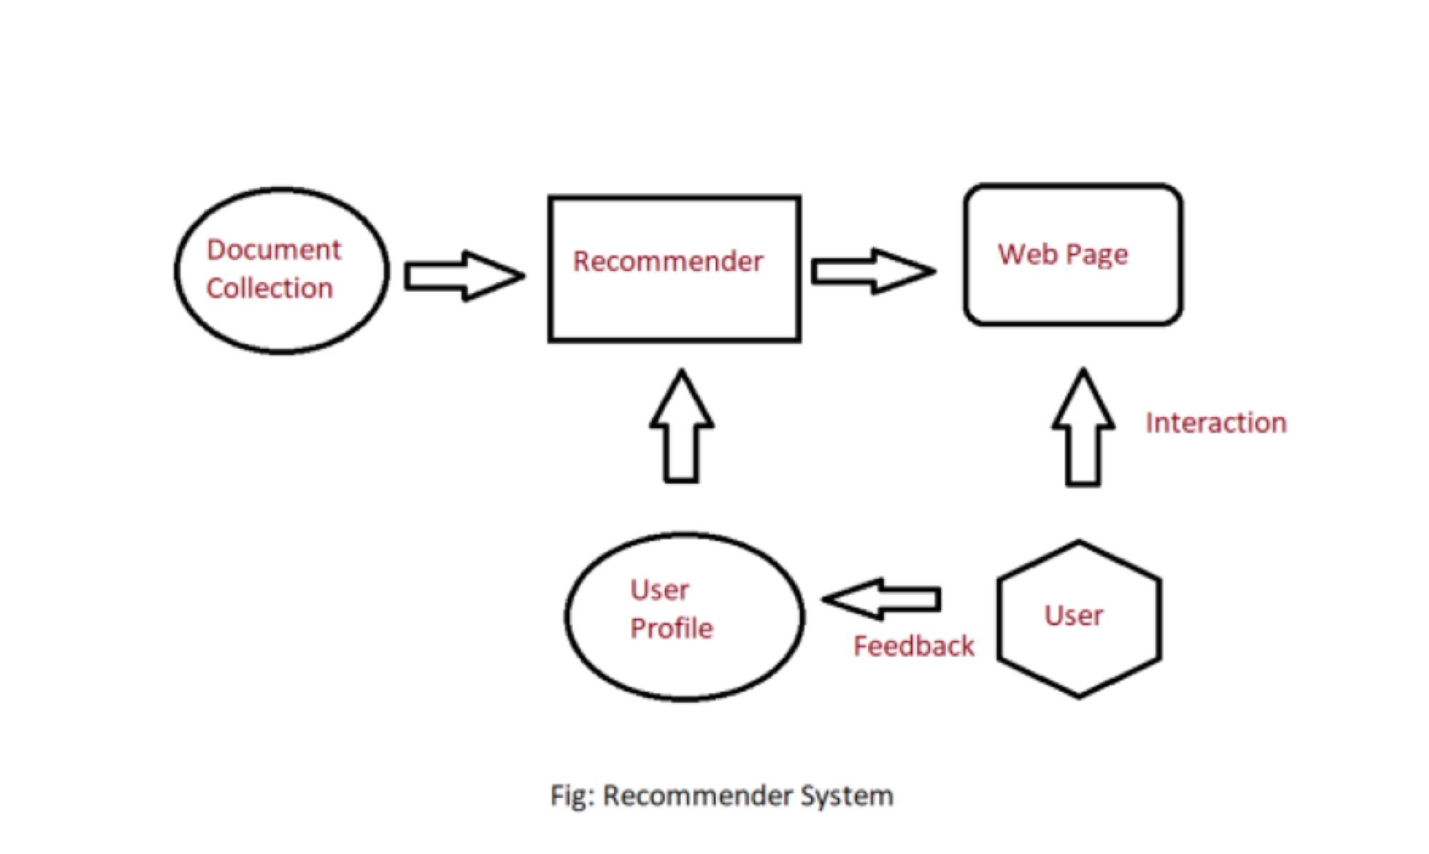
Content Based Recommendation System

Slide 45
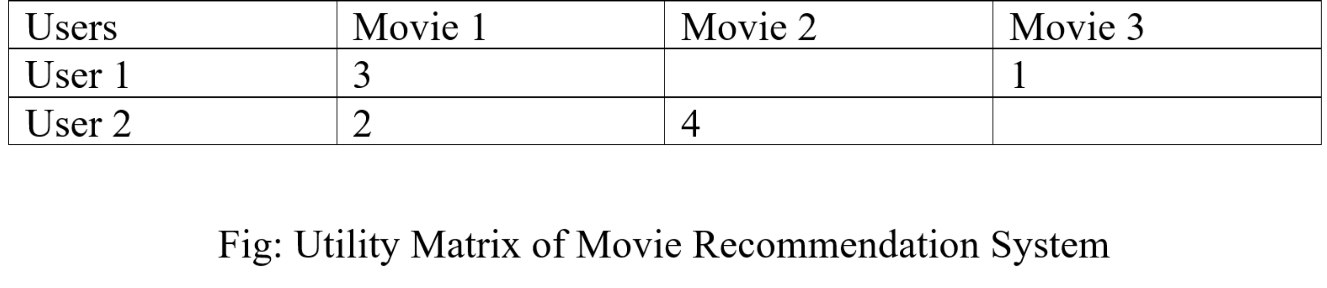
Content Based Recommendation System
Utility Matrix:
Utility Matrix signifies the user’s preference with certain items. In the data gathered from the user, we must find some relation between the items which are liked by the user and those which are disliked, for this purpose we use the utility matrix. In it we assign a particular value to each user-item pair, this value is known as the degree of preference. Then we draw a matrix of a user with the respective items to identify their preference relationship.

Slide 46
Content Based Recommendation System
Recommending Items to User Based on Content:
Method 1:
We can use the cosine distance between the vectors of the item and the user to determine its preference to the user. For explaining this, let us consider an example:
We observe that the vector for a user will have a positive number for actors that tend to appear in movies the user likes and negative numbers for actor's user doesn’t like, Consider a movie with actors which user likes and only a few actors which user doesn’t like, then the cosine angle between the user’s and movie’s vectors will be a large positive fraction. Thus, the angle will be close to 0, therefore a small cosine distance between the vectors.
It represents that the user tends to like the movie, if the cosine distance is large, then we tend to avoid the item from the recommendation.
Method 2:
We can use a classification approach in the recommendation systems too, like we can use the Decision Tree for finding out whether a user wants to watch a movie or not, like at each level we can apply a certain condition to refine our recommendation. For example:

Slide 47
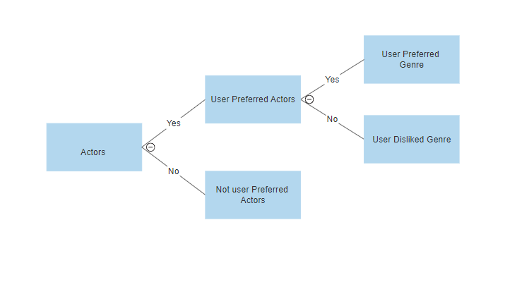
Content Based Recommendation System
Method 2 :

Slide 48
Collaborative Filtering
Traced back to the Information Tapestry project at Xerox PARC
It allowed its users to annotate the documents that they read, and system recommends
Expanded to “automatic” CF in the works of Resnick, Ridel, Mae's
More general definition as ‘the process of filtering or evaluating items using the opinions of other people.’
CF recommends items which are likely interesting to a target user based on the evaluation averaging the opinions of people with similar tastes
Key idea: people who agreed with me in the past, will also agree in the future.
On the other hand, the assumption of Content-based recommendation is that Items with similar objective features will be rated similarly.

Slide 49
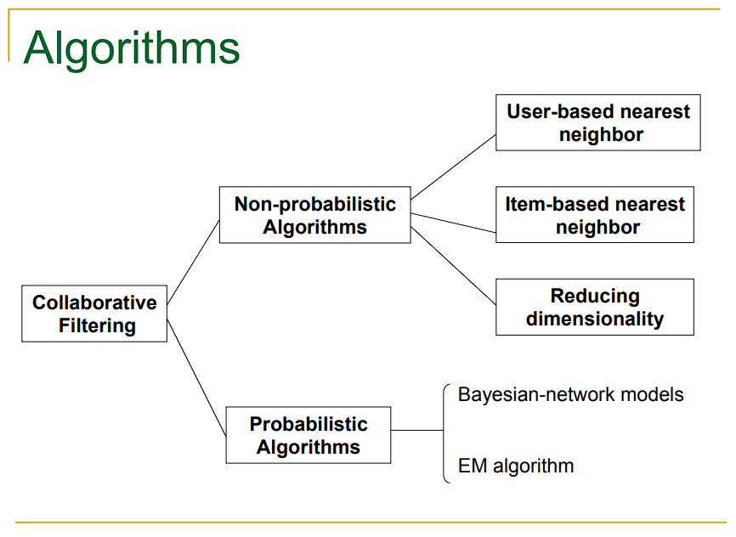
Collaborative Filtering

Slide 50
Collaborative Filtering
The goal of collaborative filtering is to predict how well a user will like an item that he has not rated given a se t of historical preference judgments for a community of users.
Benefits of Collaborative Filtering :
Collaborative filtering systems work by people in system, and it is expected that people to be better at evaluating information than a computed function
CF doesn’t require content analysis & extraction n Independent of any machine-readable representation of the objects being recommended.
Works well for complex objects (or multimedia) such as music, pictures and movies .
More diverse and serendipitous recommendation .

Slide 51
Collaborative Filtering
Uses for CF : System Tasks :
What CF systems support.
Recommend items ,
E.g., Amazon.com .
Predict rating for a given item q Constrained recommendations .
Recommend best items from a set of items .

